Slide 1
Medical Support Team
Spotter Overview

Slide 2
Thank You!
Thank you for your participation as a Medical Support Team volunteer for the 2020 Hawai‘i Pacific Health Great Aloha Run!
These slides will provide you with information about your race responsibilities. Please read them carefully in preparation for race day.
Please refer to the “Medical Team Support Guide” for further information.

Slide 3
Logistics
Details regarding equipment to bring, attire, parking, arrival times, check in, signing in and out, food and drink, etc. will be emailed to you and can also be found in the “Medical Team Support Guide” which is included with this course.
You will be given your assigned position when you check in with your Medical Lead on race day.
After you check in, there will be a mandatory orientation with your team.

Slide 4
Be on the lookout…
After receiving your assignment, work with your team lead to be assigned a buddy with a First Aid Pack. Position yourself at your designated post and orient yourself to your surroundings.
Buddies should be separated on the course for maximum coverage, but should be in sight distance of each other.
Note specific landmarks that will help clearly specify the location of downed participants.
Survey for participants that may need assistance, medical aid, or appear to be in distress.
Help get assistance for the participant. Do not provide aid yourself.
Stay with the participant until they have been cared for or moved to another location

Slide 5
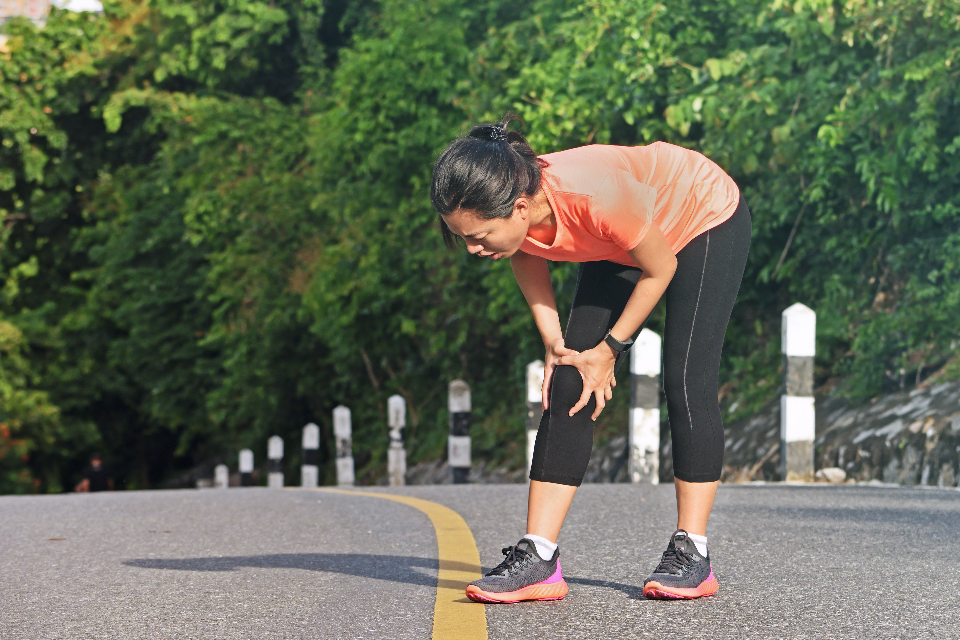
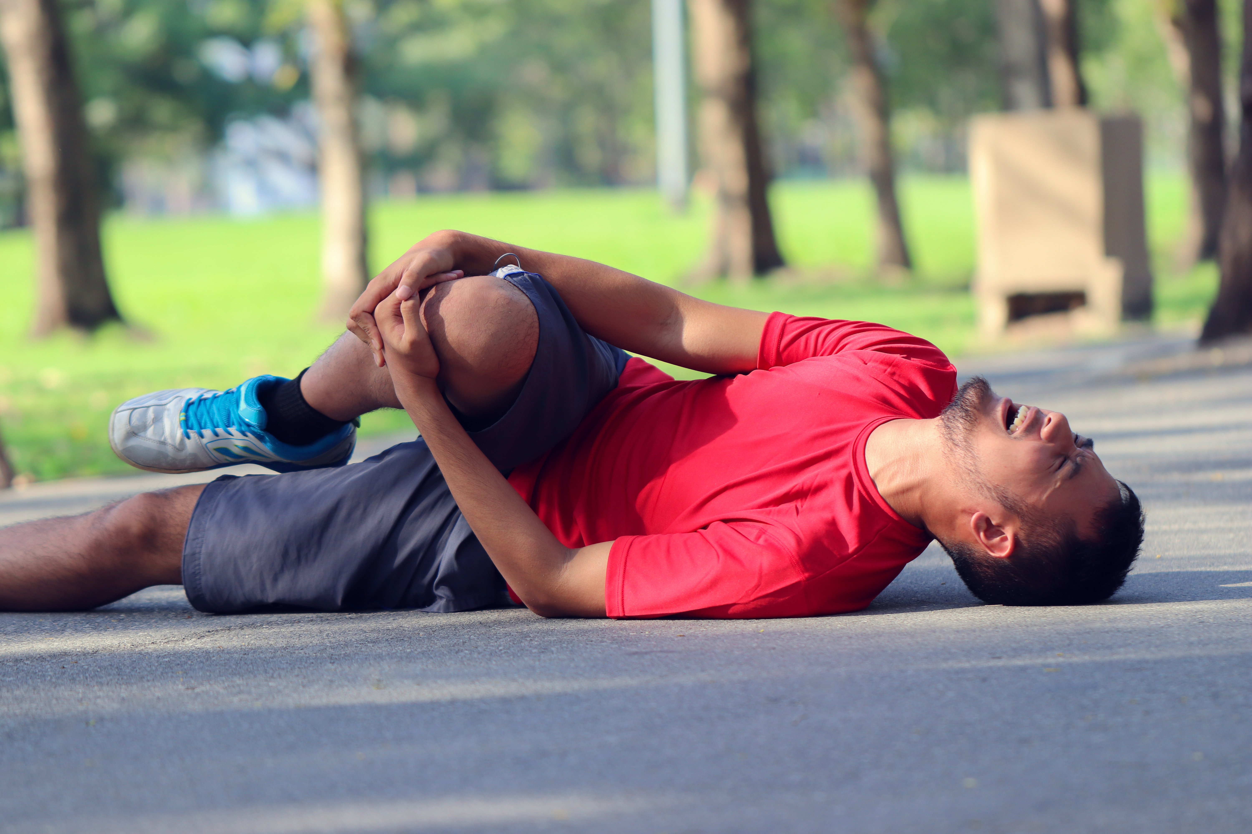
Common Signs of Distress
Appearance of pain or discomfort
Difficulty breathing or chest discomfort, especially if unrelieved after rest
Unable to stand or ambulate without support
Disorientation, confusion, or erratic behavior
Nausea, vomiting, or stomach pain
Excessively pale
Unconscious or fainting

Slide 6
Participant Needs Assistance
Participant is able to walk and able to communicate clearly but is in need of first aid, rest or rehydration.
Direct or escort them to the closest spotter with a First Aid Pack or to a First Aid Station for further assessment and treatment.
Return to your spotter position.

Slide 7
Participant Down
If the participant is not able to walk, unable to communicate, having breathing problems or a significant injury flag down your buddy with a First Aid Pack
Contact your Station / Zone Medical Lead
Your station will contact the Race Command Post and AMR will be dispatched if necessary.
Contact 911 if you are unable to reach your Station / Zone Medical Lead
Provide crowd control as indicated to give the participant and caregivers space

Slide 8
Communication Of Runner In Distress
If you have a radio, contact the Race Command Post.
If you see a volunteer with a radio, have them contact the Race Command Post.
GAR volunteer radio operators will be wearing orange vests and will be placed throughout the course and the stadium.
If they are nearby, flag them down and they will assist with communication.
Follow the Radio Protocol
Otherwise, use your cell phone to contact:
Your Aid Station / Zone Medical Lead who can contact the Race Command Post
Or contact 911 if you are unable to reach your Station / Zone Medical Lead
Information to Convey:
Your name and that you are a GAR Spotter
Participant’s Bib number
Your Assigned Station / Zone
Precise location of the runner / walker – use landmarks – be specific
Specifics regarding their condition

Slide 9
Participant Privacy
Under NO circumstances should any comments be made to anyone, including the media.
If you receive a media or press inquiry, please direct them to the HPH Media Coordinator or Race Director and say,
“I’m not authorized to speak to the press.”
Cell phones should be used for GAR medical support team communication purposes only.
No photos or videos are allowed of any participants in distress or undergoing care.
No photos or videos are allowed in any of the First Aid Tent or Medical Support Zone areas.
Only approved photographers and HPH Media Coordinators may take photos

Slide 10
Ambulance
If an ambulance is dispatched to the scene:
Make yourself or a designee visible to the ambulance to flag the ambulance to the scene
Establish crowd control for ambulance access and around the scene to provide privacy and space for caregivers
Once on the scene, the ambulance paramedics will take over the care of the participant. Medical Support Team members will yield to the care of the paramedics
Do not leave the scene, paramedics may need your assistance

Slide 11
Next Steps
Prepare for your volunteer experience by:
Visiting the area of your assigned position in advance and confirming parking location
Reading the Medical Team Support Guide
Be familiar with
What you’ll be expected to do
Protocols and guidelines for your role
When you need to arrive – plan for extra time due to traffic and road closures
What you need to bring
Where you will be expected to report
What attire to wear
Getting enough rest
Get and stay hydrated

Slide 12
Resources
Medical Team Support Guide
Download and save the guide to your personal drive or PC computer for future reference
Completed HLC GAR Courses (HPH Employees Only)
Once you complete a course in the HLC, it will appear in your Completed tab
Completed courses may be accessed at any time for review or future reference
Contact
HPH GAR Volunteer Coordinator
Email: Events@HawaiiPacificHealth.org

Slide 13
Thank you very much!
Your participation on the GAR Medical Support Team is deeply appreciated. We couldn’t do it without you!

