Slide 1
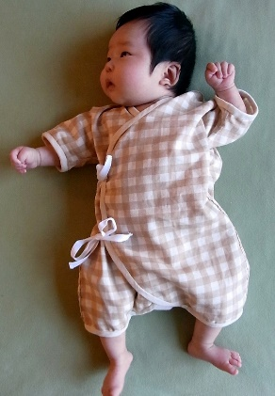
Secrets of Baby Behavior
Tuesday, May 22, 2018
1:00 PM – 4:00 PM
Carolyn L. Melcher, MPH, BSN, RN
Location: Childbirth Education Classroom, Wilcox Medical Center
Disclosure: There are no financial relationships/affiliations to disclose.
Audience: Mother-Baby Nurses
Registration: No registration required.
Learning Objectives: At the conclusion, participants should be able to:
Identify the stages of sleep and alertness of the neonate.
Instruct the family of recognition of stages of sleep and alertness for the newborn.
Promote functional breast feeding habits by recognizing hunger cues of the newborn.
Continuing Education Information:
In support of improving patient care, Hawai‘i Pacific Health is jointly accredited by the Accreditation Council for Continuing Medical Education (ACCME), the Accreditation Council for Pharmacy Educa- tion (ACPE), and the American Nurses Credentialing Center (ANCC), to provide continuing education for the healthcare team.
Hawai‘i Pacific Health designates this live activity for a maximum of 3.0 contact hours for nurses.
Free CE/CME: 3 hours
Contact Paula Hulme 245-1137

