Slide 1
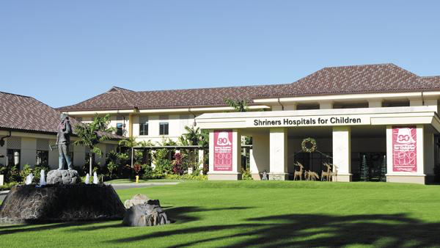
11th Aloha Pediatric Infectious Diseases Conference
held at Honolulu Shriners Hospital for Children
September 8, 2018 12:00 to 5:00 pm
Faculty:
Marian Melish, M.D. Professor of Pediatrics, University of Hawai`i, John A. Burns School of Medicine.
Natascha Ching, M.D. Assistant Professor of Pediatrics, University of Hawai`i, John A. Burns School of Medicine.
Elizabeth MacNeill, M.D., M.P.H., Chief, Tuberculosis Control Branch, Hawaii Department of Health.
Raul Rudoy, M.D., M.P.H. Emeritus Professor of Pediatrics, University of Hawai`i, John A. Burns School of Medicine.
https://www.hawaiipacifichealth.org/health-wellness/continuing-education/2667

Slide 2
11th Aloha Pediatric Infectious Diseases Conference
held at Honolulu Shriners Hospital for Children
September 8, 2018. 12:00 to 5:00 pm
Objectives:
Upon completion of this conference you will be able to:
Interpret the epidemiology, clinical features, prevention and management of patients with pediatric tuberculosis.
Formulate the differential diagnosis and management plan for children presenting with complicated cardiovascular infections.
Recognize the most recent recommendations for the diagnosis and treatment of complicated pneumonia.
Recognize changes in the immunizations schedule and develop a rational approach to answer common parental concerns regarding immunizations.
Apply strategies to improve inter-professional collaboration to increase pediatric vaccination rates.
In support of improving patient care, Hawai‘i Pacific Health is jointly accredited by the Accreditation Council for Continuing Medical Education (ACCME), the Accreditation Council for Pharmacy Education (ACPE), and the American Nurses Credentialing Center (ANCC), to provide continuing education for the healthcare team.
Hawai‘i Pacific Health designates this live activity for a maximum of 4.0 AMA PRA Category 1 Credit (s) ™ for physicians and 4.0 contact hours for nurses. This activity is also assigned the Joint Accreditation Universal Activity Number (UAN) JA4006398-0000-18-001-L04-P and is accredited for 4.0 hours for pharmacists.
In compliance with the Americans with Disabilities Act of 1990, Shriners Hospital for Children will make all reasonable efforts to accommodate persons with disabilities.

Slide 3
Program Agenda:
12:00-12:30 pm Registration-Lunch
12:30-1:00 pm Elizabeth MacNeill, M.D., M.P.H.
1:00-1:30 pm Marian Melish, M.D.
1:30-1:45 pm Break
1:45-2:15 pm Natascha Ching, M.D.
2:15-3:15 pm Raul Rudoy, M.D., M.P.H.
3:15-3:30 pm Break
3:30-5:00 pm Workshop and Clinical Cases Discussions
Planning Committee:
Pam Carey-Goo, RN, Infection Control Coordinator, Shriners Hospital
Natascha Ching, MD Assistant Professor of Pediatrics, JABSOM
Jennifer Dacumos, Pharm D, Hawai‘i Pacific Health
Raul Rudoy, MD Emeritus Professor of Pediatrics, JABSOM
Amy Thomas, Hawai‘i Pacific Health
Kara Yamamoto, MD Assistant Professor of Pediatrics, JABSOM
Mahalo to our sponsors: the Honolulu Shriners Hospital for providing our conference location and to HPAREF for their generous support

